Slide 1



10 February 2026
x

Slide 2
6th week: Sampling Coordination
Activites:
Maintain regular communication with all vendors to track progress and updates.
Conduct research on packaging requirements, including compliance and labeling needs.
Deliverables:
Packaging mockup
Standard details printed in the packaging.

Slide 3
Sample Tracker
VENDOR | MOQ | SAMPLE FEE | SAMPLE LEAD TIME | PROFORMA INVOICE | STATUS | Quantity | Date Payment Made | CNY Closure | Estimated Finish Date | Shipping Method
Shenzhen Funxim Innovation Technology Co., Ltd. | 1000 | $500 | 20 days | PI | PAYMENT CONFIRMED | 2 | 01/29/2026 | 02/08-02/24 | 03/15 | AIR
Abc (shenzhen) Electronics Co., Ltd | 1000 | $800 | 10 - 15 days | PI | PAYMENT CONFIRMED | 6 | 01/29/2026 | 02/10-02/26 | 03/15 | AIR

Slide 4
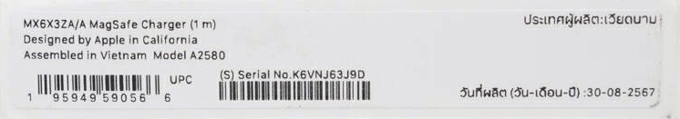
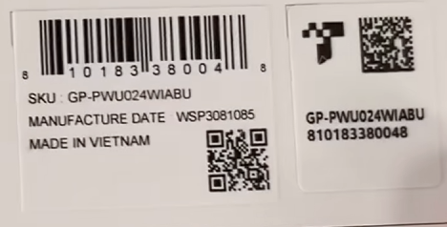
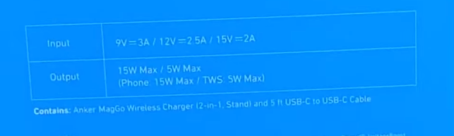
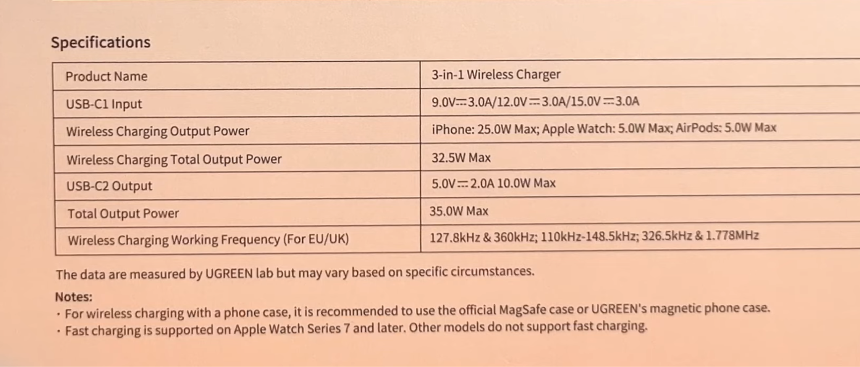
PACKAGING REQUIREMENTS
Product model number, name, and serial number:
Electrical characteristics (e.g., current, voltage, frequency):

Slide 5



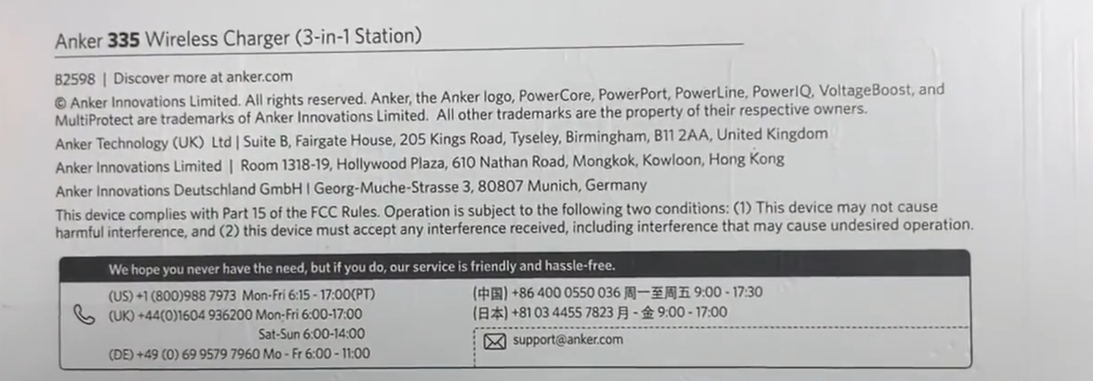
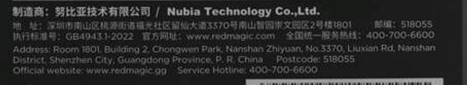
PACKAGING REQUIREMENTS
Certifications
Maker/importer contact information

Slide 6
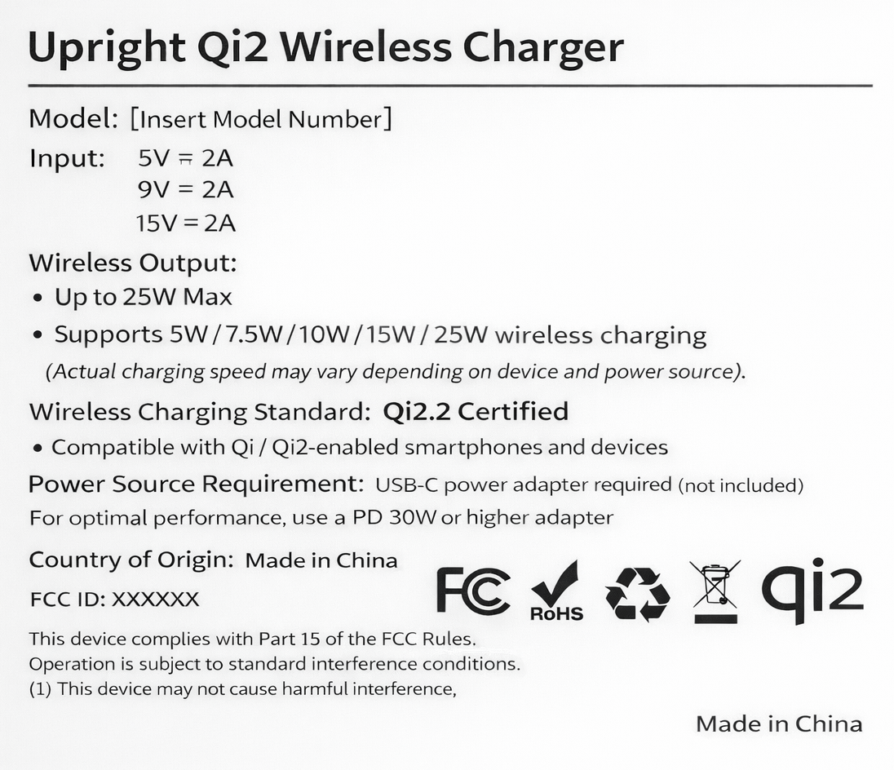
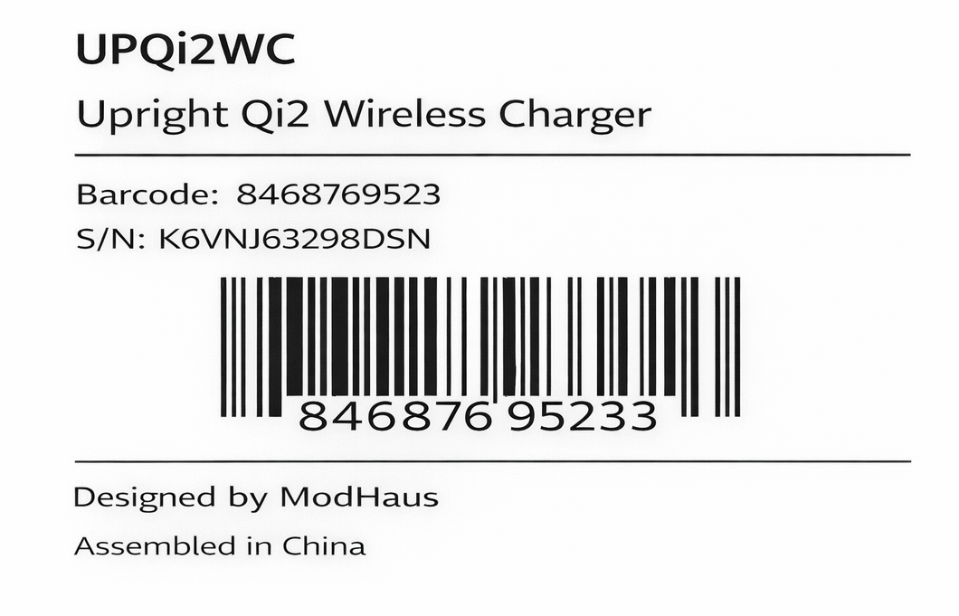
PACKAGING DETAILS - REQUIREMENTS

Slide 7
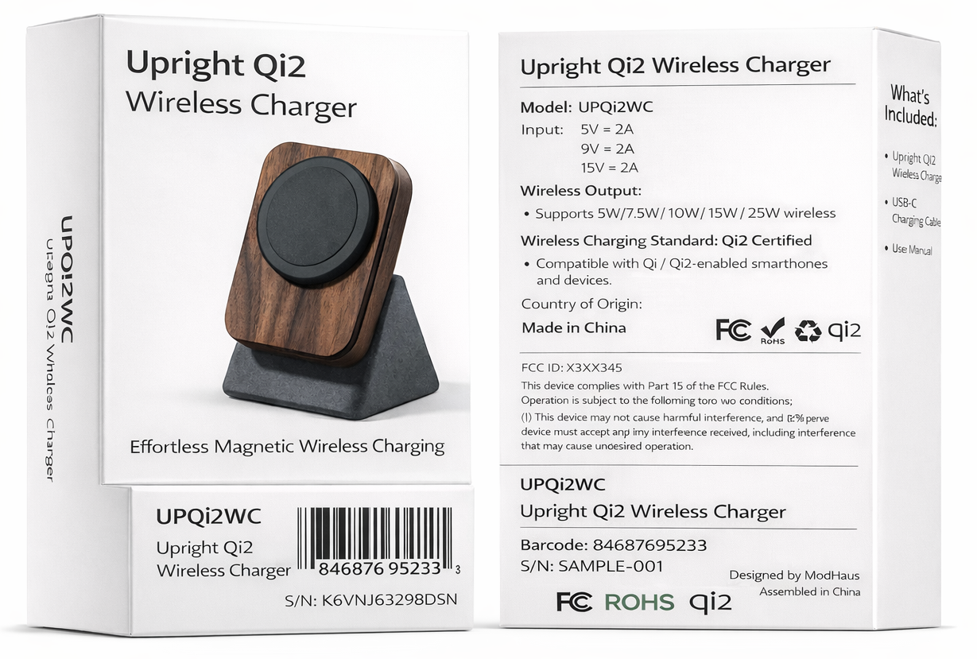

Slide 8
Next Steps:
Design and finalize product packaging
Design and finalize the user manual
Design the quick start guide
Design the warranty card and claims documentation

Slide 9

Thank you!

Slide 10
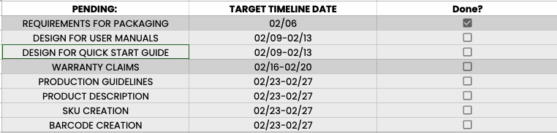

Slide 11
Key Performance Indicators
KPI | Commitment | Metrics
Vendor Sourcing | Deliver vetted supplier shortlists across the full outsourced build by the end of Month 1 | Shortlists delivered for: (1) Qi2 internals, (2) concrete base, (3) wood components, (4) packaging, and (5) assembly pathway, each with capability notes, risk flags, and RFQs collected
Cost Optimization | Identify cost-saving opportunities | % COGS savings by looking at alternative vendors benchmarked vs current vendors
Sample Coordination and DFM | Manage sampling and DFM checks against drawings and finish specs | Samples delivered per SKU with DFM checklist and written feedback
QA and Validation Readiness | Establish a clear QA and validation checklist for the internals and ensure required documentation is collected and organized before PO | QA checklist delivered, documentation tracker maintained (spec sheets, test reports where available, QC approach, compliance related documents)
PO Placement Readiness | Provide a PO-ready recommendation and support through first PO placement by the end of Month 3 | Final supplier scorecard, negotiated commercial terms summary (price, MOQ, lead time, payment terms where feasible), and PO-ready package shared

Slide 12
Scope of Work (Modhaus)
SUPPLY CHAIN FACET | OBJECTIVE | APPROACH | EXPECTED OUTCOME
End-to-End Sourcing and Vendor Management | Build a complete, vetted supplier ecosystem for a fully outsourced product, internals, concrete, wood, packaging, and an assembly pathway, so Modhaus can scale production without founder bandwidth becoming the constraint. | Translate requirements into supplier-ready briefs for each lane (Qi2 internals, concrete base, wood components, packaging, assembly) Identify, outreach, and qualify suppliers based on capabilities, finish quality, documentation readiness, MOQ flexibility, lead times, and responsiveness Collect RFQs and benchmark options apples-to-apples across lanes (unit cost drivers, tooling, sample costs, MOQs, lead times) Build scored shortlists per lane with clear tradeoffs and risk flags, then define the recommended integration model (single integrator vs multi-partner build) | A vetted set of supplier shortlists, RFQs, and a clear recommended build model, with real numbers that allow an informed decision between full outsource vs hybrid.
Sampling Coordination and Integration Management | Validate fit, finish, and compatibility across components and suppliers, and prove the assembly path before moving into production. | Issue structured sample request packs to shortlisted suppliers, including tolerances, finish standards, and integration constraints Coordinate sampling timelines across lanes and manage supplier Q&A so requirements stay clear and documented Manage iteration loops to resolve gaps uncovered in sampling (fitment, finish matching, tolerance issues, packaging fit, assembly flow) Develop an integration plan that clarifies component interfaces, ownership of assembly steps, and how issues will be resolved without stalling the timeline | Sample outcomes that confirm the product can be built consistently through the outsourced model, with reduced integration risk and a clear path to final supplier selection.

Slide 13
Scope of Work (Modhaus)
SUPPLY CHAIN FACET | OBJECTIVE | APPROACH | EXPECTED OUTCOME
QA, Validation Readiness, and PO Placement | Ensure the outsourced build can meet performance and quality expectations, then support a PO-ready decision and initial PO placement. | Establish a practical QA and validation checklist for V1 across the complete product (performance expectations, heat behavior, finish consistency, packaging integrity, documentation requirements) Maintain a documentation tracker (spec sheets, test reports where available, QC approach, compliance-related materials, packaging specs) Support commercial alignment and negotiation where feasible (MOQ, price breaks, lead times, payment terms) Deliver a PO-ready package: final supplier scorecards, build and assembly plan, confirmed assumptions, and a recommended first production plan designed for scale | A clear supplier ecosystem and PO-ready recommendation backed by real sample outcomes and documentation, enabling Modhaus to place the first production order with confidence and a defined ramp path for scaling.

Slide 14
✅ Month 2: Sampling Coordination & Integration Validation
ACTIVITIES
DELIVERABLES
Issue structured sampling request packs to shortlisted suppliers, including:
Technical specs and tolerances
Finish and material standards
Integration and interface constraints
Coordinate sampling timelines across all lanes to ensure alignment.
Manage supplier Q&A to maintain clear, documented requirements.
Oversee sample reviews and manage iteration loops to resolve:
Fitment and tolerance issues
Finish and material inconsistencies
Packaging fit and protection concerns
Assembly flow and handoff challenges
Develop an initial integration and assembly pathway, clarifying:
Component ownership
Assembly responsibilities
Issue resolution and escalation flow
Sample tracking dashboard with timelines and iteration status
Sample review summaries with gap analysis and recommendations
Defined integration and assembly model options
Updated supplier scorecards based on sampling outcomes

Slide 15
✅ Month 3: QA Readiness, Commercial Alignment & PO Preparation
ACTIVITIES
DELIVERABLES
Establish a practical QA and validation checklist for V1 production covering:
Performance expectations
Heat behavior and durability (where applicable)
Finish consistency
Packaging integrity
Documentation and compliance readiness
Maintain a centralized documentation tracker:
Spec sheets
Test reports (where available)
QC processes
Packaging specs and requirements
Support commercial alignment and negotiation where feasible:
MOQ adjustments
Price breaks
Lead time commitments
Payment terms
Finalize supplier scorecards and confirm recommended sourcing and assembly model.
Package all inputs into a PO-ready recommendation designed for scalable production.
Final supplier scorecards and risk assessment
QA and validation checklist for first production run
Confirmed build and assembly plan
PO-ready package including:
Final supplier recommendations
Confirmed assumptions and constraints
Recommended first production plan and ramp path

Slide 16
✅ Month 1: Supplier Discovery, Qualification & RFQ Benchmarking
ACTIVITIES
DELIVERABLES
Translate Modhaus product requirements into supplier-ready briefs for each sourcing lane:
Qi2 internals
Concrete base
Wood components
Packaging
Assembly pathway
Identify, outreach, and pre-qualify suppliers across all lanes based on:
Technical capability and finish quality
Documentation readiness and communication responsiveness
MOQ flexibility and lead times
Experience with similar materials or assemblies
Collect RFQs from qualified suppliers and normalize inputs for apples-to-apples comparison:
Unit cost and cost drivers
Tooling and sample costs
MOQs and scalability constraints
Lead times and production assumptions
Begin early risk mapping per lane (integration complexity, dependency risks, cost volatility).
Supplier longlist per lane with qualification notes
Standardized RFQ comparison matrix across all lanes
Initial risk and feasibility assessment
Shortlisted supplier candidates for sampling phase

